Slide 1
Recorder’s Perpetuation Fund
IC: 36-2-7-10

Slide 2
IC 36-2-7-10
The purpose for the Record Perpetuation fund: •
(1) the preservation of records
(2) the improvement of record keeping systems and equipment; within the control of the recorder
• Money in the fund may not be deposited or transferred into the county general fund and does not revert to the county general fund at the end of the year.
• Money may be disbursed without appropriation

Slide 3
Operating Expenses From Perpetuation Fund
• IC 36-2-7-10.2 (b) “A county recorder may pay all or a portion of the expenses of the county recorder’s office for the following calendar year only if:
• Key Phrases: • May - not shall • Following calendar year- specific time frame • Expenses – other than those associated with preserving records • Only if – conditions that must be met

Slide 4
Sworn Statement
Sworn Statement • (1) the county recorder submits to the county fiscal body for approval a sworn statement that:
• (A) the current revenue to the fund is sufficient to fulfill the statutory purpose of the fund;
• (B) the technology of the county recorder’s office is presently updated and at a level to sufficiently meet the statutory purpose of the fund and the county recorder’s office;
• (C) the fund has sufficient reserve, consistent with the recorder’s plan, to capitalize the next technology or other records management upgrade necessary to fulfil the statutory purpose of the fund and the county reorder’s office;
• (D) the county recorder specifically requests that all or a specific, identifiable portion of the fund be used to pay the expenses of the county recorder’s office for the following year.

Slide 5
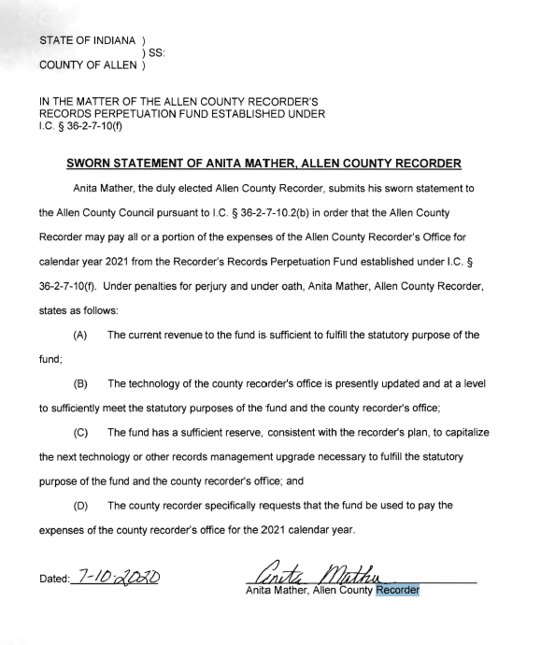
Example of an Affidavit

Slide 6
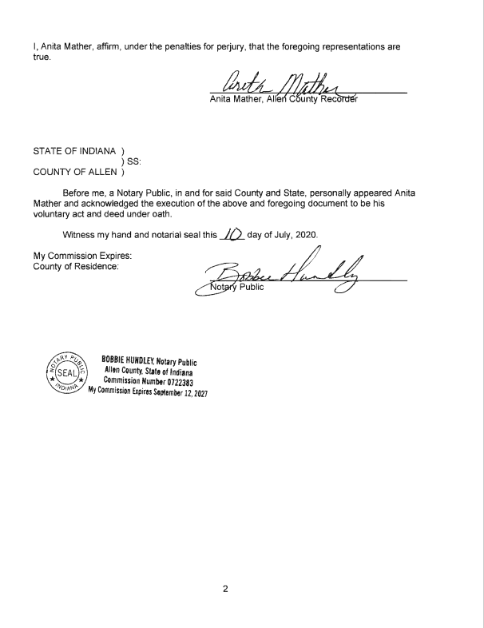

Slide 7
Questions
11/01/2022

